Slide 1
Introduction to Data Warehousing and multi-dimensional Modeling
UNIT III

Slide 2
3.1 Operational Vs Decisional Support System ,The Need for Data Warehousing
3.2 Data Warehouse Definition, Features , The Information Flow
Mechanism, Architecture , Role of Metadata, Classification of Metadata
3.3 Data Warehouse Vs Data Marts, Data Warehousing Design
Strategies, Data Warehouse Modeling Vs Operational Database Modeling
3.4 The Star Schema - Fact Tables and Dimension Tables, The Fact less Fact
Table, Keys in the Data Warehouse Schema- Primary Keys, Surrogate Keys
& Foreign Keys, The Snowflake Schema, Fact Constellation Schema
(Family of Stars)

Slide 3
3.5 Updates To Dimension Tables - Slowly Changing Dimensions, Type 1,
Type 2 and Type 3 Changes, Large Dimensions , Rapidly
Changing Dimensions, Junk Dimensions, Aggregate Fact Tables
3.6 Data lake, Architecture of Data lake, Data Warehouse Vs Data lake

Slide 4
Operational Vs Decisional Support System
Operational Support Systems | Decisional Support Systems
Data represented by operational support systems are transactions that happen in real time | Decision support systems use the operational data at a particular point in time.
Operational data is regarded as update transactions. | Decisional support data is regarded as query transaction. Which is read-only.
The concurrent transaction volume in operational data is very high. | The concurrent transaction volume is found at low or medium levels.
Operational data usually consists of information about transactions and is stored in numerous tables. | Decisional support data is usually stored in less number of tables that store data derived from the operational data.

Slide 5
The Need for Data Warehousing
It is difficult to retrieve data from tables for analytical purposes.
Data warehousing is the best way to integrate valuable data from different source into the database of a particular application.
Data warehouses make it easy to develop and store metadata.
Business experts or users become habitual to see many customized data on display screens fields such as rolled-up general ledger balances. These fields do not exist in the database.
When we perform reporting and analysis functions on the hardware that handles transactions, the performance is often poor. Therefore, data warehouse should be used for reporting and analysis.

Slide 6
Data Warehousing : An Information Environment
Data warehouse helps organization to fulfil their information related requirements. Therefore, it is also called as an information environment.
Information environment:
Offers an integrated and entire view of the enterprise
Avails the enterprise’s current and historical information easily for decision making.
Provides steady and reliable Information
Makes decision-support transactions possible without hampering operational systems.
Grants a flexible and interactive source of strategic information.

Slide 7
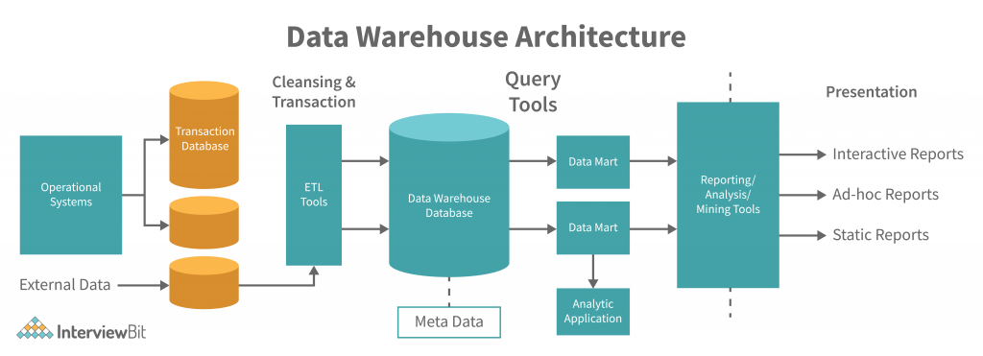

Slide 8
The following is the description of the layers of the data warehouse system:
Data Source Layer: Refers to the layer representing various data sources that enter data into the data warehouse. The data can be in any of these formats: Plan text file, relational database, excel file and other types of databases.
The following are the types of data that can act as data sources:
Production Sources: Represents sales data, HR data and product data.
Internal Data: Represents data of a department or an organization such as employee data
External Data : Represents data from outside the organization or third party data such as census data or demographic or survey data.
Achieved data: Represents logs of the Web server along with the user’s browsing data

Slide 9
Data Staging Layer: Refers to the storage area for data processing where data comes before being transformed into the data that is entered in a data warehouse. The following are the steps involved in transporting data from various sources to data warehouse:
Extraction: Refers to the process of extracting data from different source systems and validating it against certain quality.
Transformation: Refers to the transformation of the data available in different source systems and validating it against certain quality.
Loading: Refers to the process of loading the data either from data warehouse or data mart.

Slide 10
Data Storage Layer: Refers to the layer in which the transformed data and clean data is stored. On the basis of the scope and functionality. The following are the types of entities in this stage.
Data warehouse : It is maintained by organizations as central warehouse of data that can be equally accessed by all business experts and end users.
Data Mart : When data warehouse is created at the departmental level. It is known as data mart.
Meta Data: Details about the data is known as metadata. In other words, it is a catalog of data warehouse.
MDDB: It is multidimensional database that allows data to be molded and viewed in multiple dimensions. It is defined by dimensions and facts.
Information Delivery: Provide information that reach to end users.

